Slide 1
Natural ADABAS

Slide 2
Section 01 - Natural
Programming Language

Slide 3





Course curriculum
Natural concepts
Editors
Type of module
Statements
Other concepts
Natural Logical flow
Loop, Logical conditions
Module navigation
Introduction of data retrieval techniques
ADABAS
Architecture
Data retrieval in detail
- File management
ADABAS
Transaction
Performance enhancement
Compression techniques
Quick revision
Q&A session
- Overview of NaturalOne

Slide 4
What is Natural?
It is a programming language developed and marketed by Software AG
It is a 4GL programming language for the enterprise environment, is designed to increase productivity in application software design, development and deployment.
Applications developed using NATURAL are modular, which contributes to its success as a tool for Rapid Application Development. In general, each module is created, maintained and stored independently of any others. While NATURAL lends itself to an object-oriented approach to systems development

Slide 5
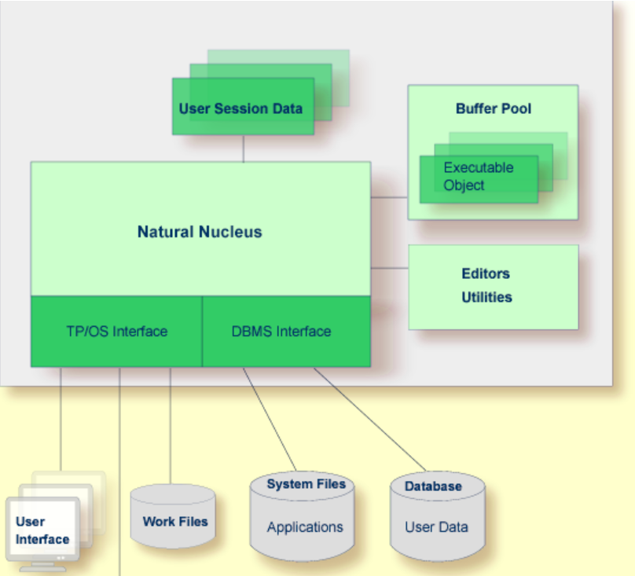
Natural Architecture

Slide 6
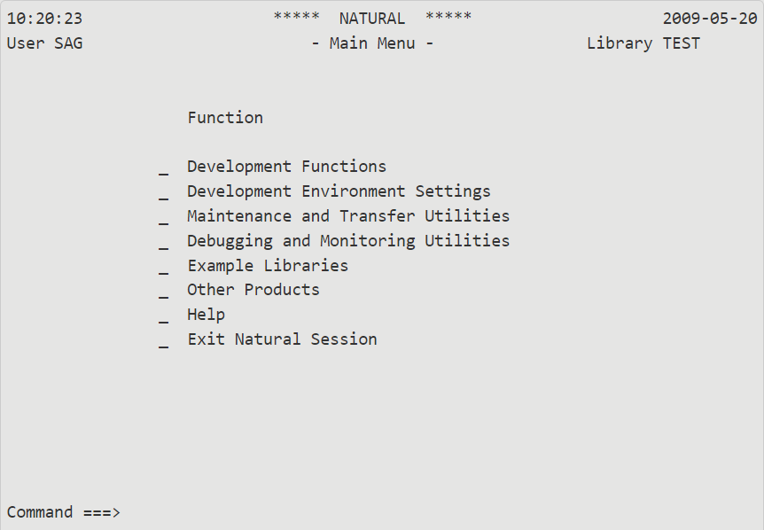
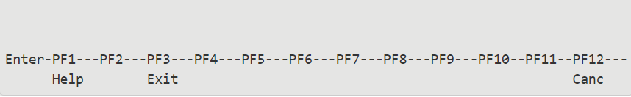
Natural Main menu

Slide 7
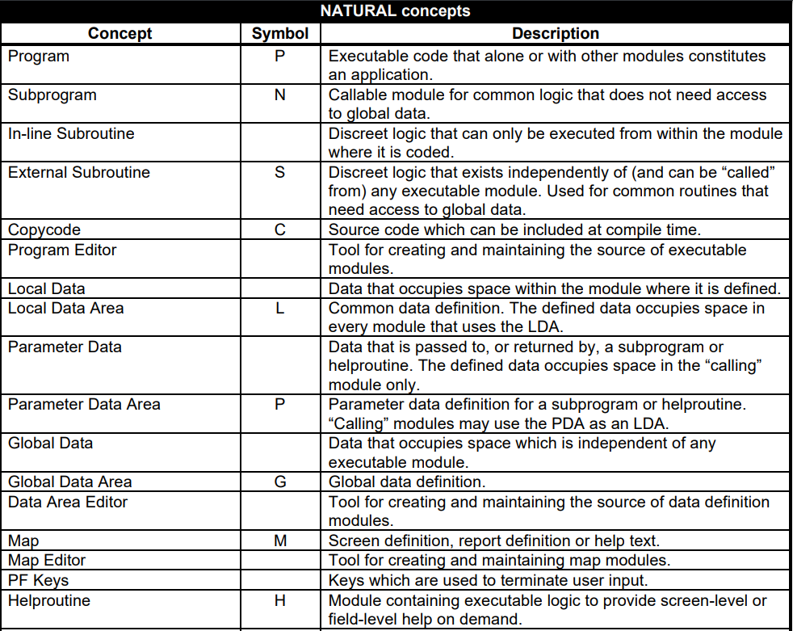
Program editors
Types of module:
Program
Subprogram
Subroutine
Copycode
Helproutine

Slide 8
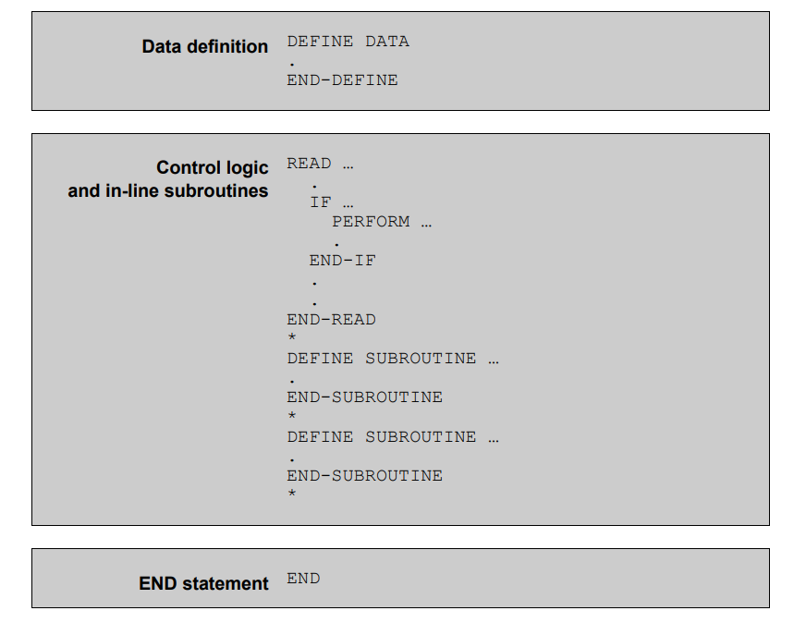
Program / Subprogram / Helproutine

Slide 9
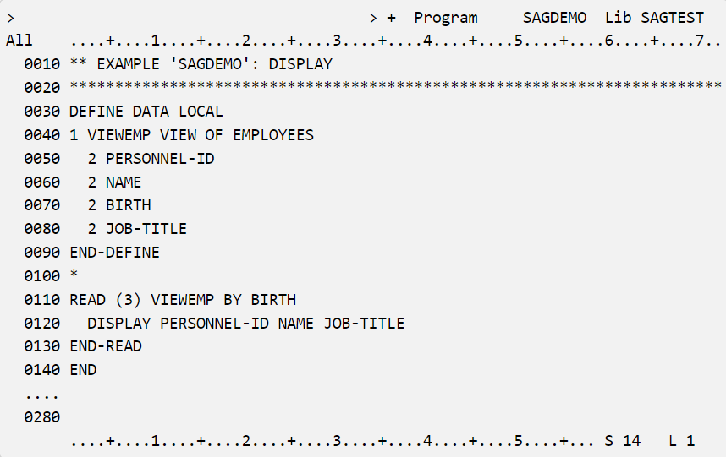
Program / Subprogram / Helproutine

Slide 10
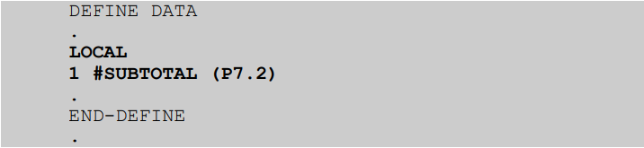
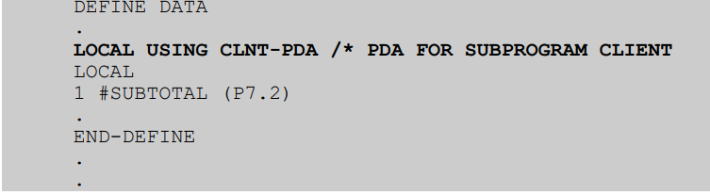
Program - Data Definition section
Types of data definition
In-line data definition
Using LDA

Slide 11
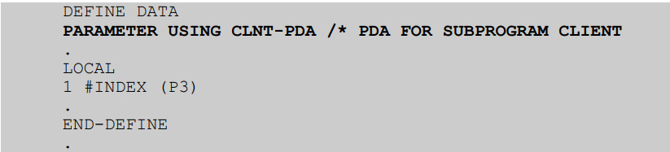
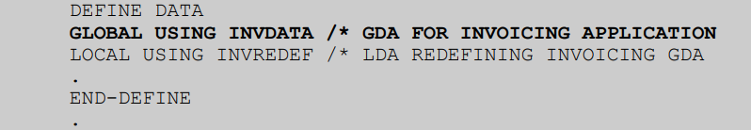
Program - Data Definition section
Types of data definition
Using PDA – For parameters
Using GDA – For Global data

Slide 12
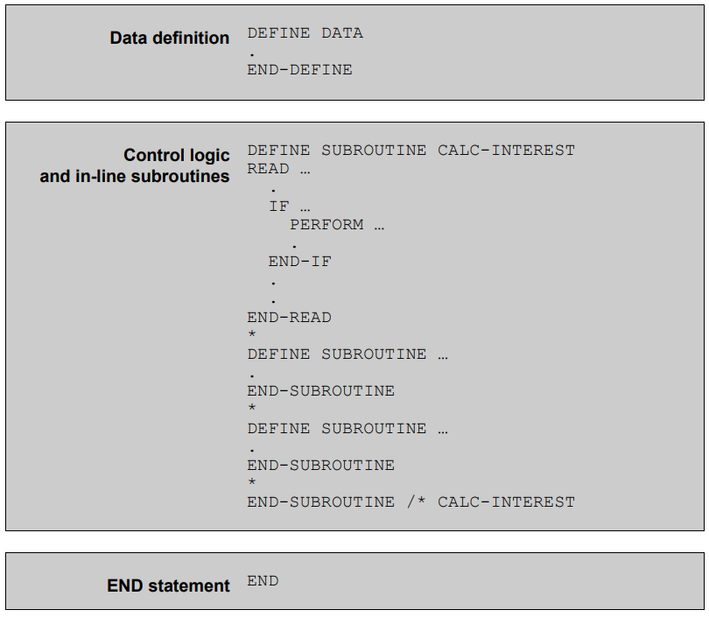
Subroutine

Slide 13
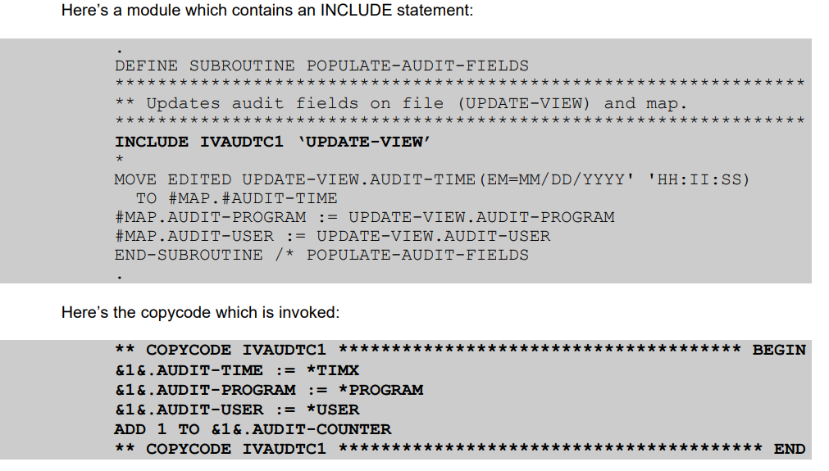
Copycode

Slide 14
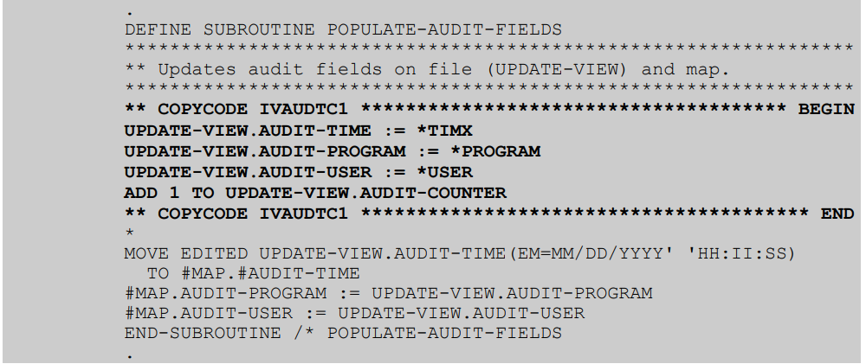
Copycode – How it works?
* Up to 98 values can be specified as parameters in an INCLUDE statement, form “&1&” through “&98&”.

Slide 15
Subroutine
Types of subroutine:
In-line
External

Slide 16
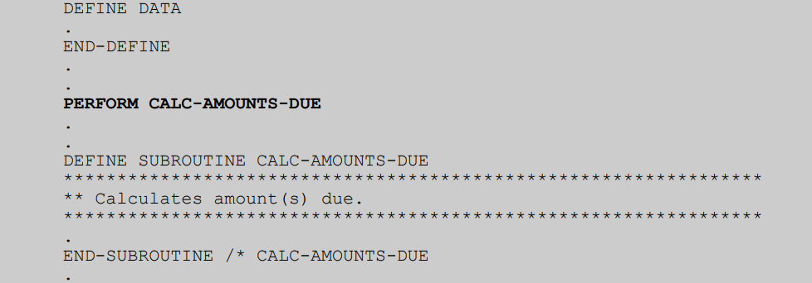
Subroutine : In-line

Slide 17
Subroutine : External
DEFINE SUBROUTINE CALC-AGE
.
.
ENTER YOUR CODE
.
.
END-SUBROUTINE
*
END

Slide 18
Text Data Area
Types of data area:
LDA – Local Data Area
PDA – Parameter Data Area
GDA – Global Data Area

Slide 19
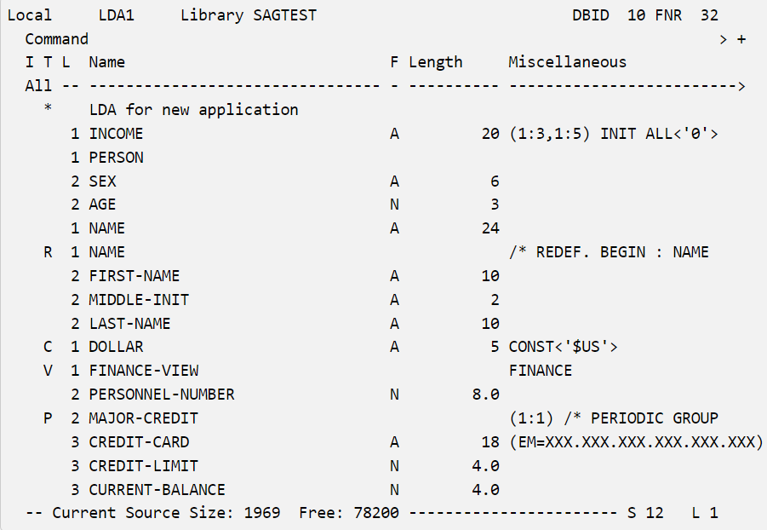
Text Data Area

Slide 20
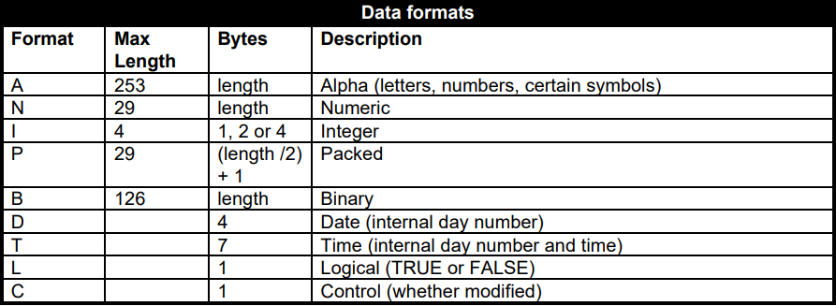
Data Format

Slide 21
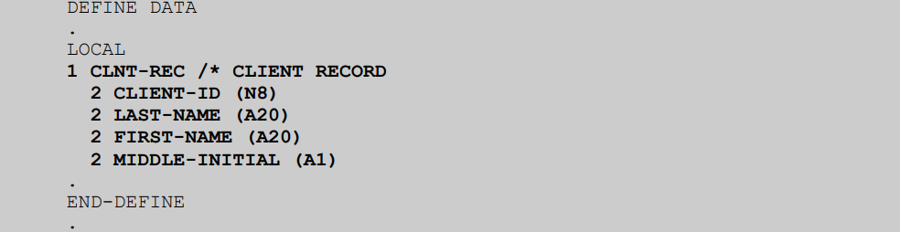
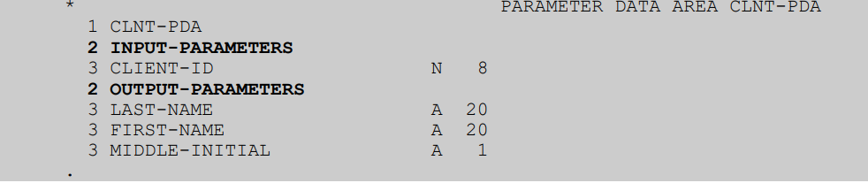
Record Structure

Slide 22
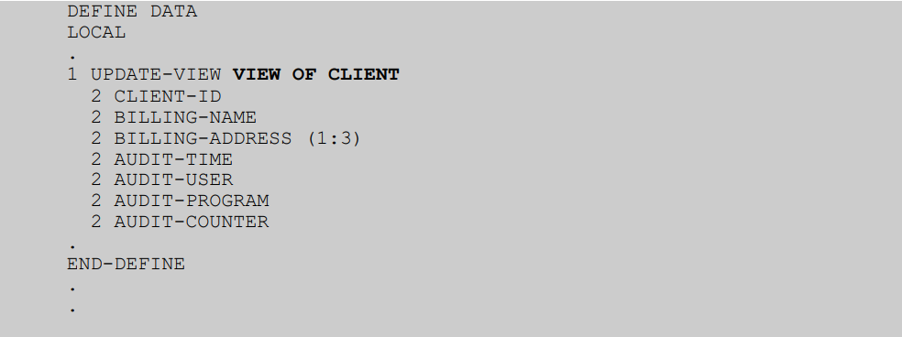
Database View

Slide 23
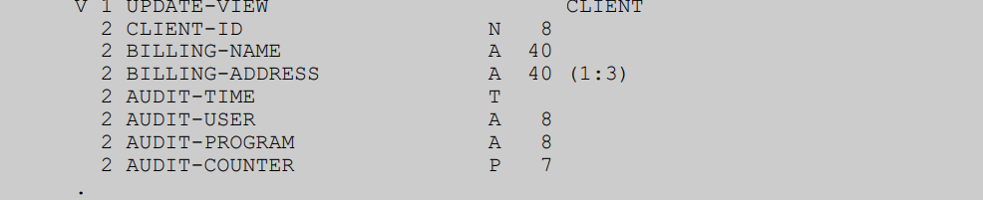
Database View in LDA/PDA/GDA
The Data Area Editor has a special .V (view) command for selecting fields from a database view. Fornat and length are derived automatically.

Slide 24
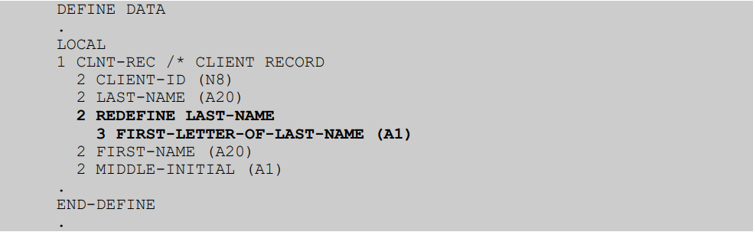
Redefining Data

Slide 25
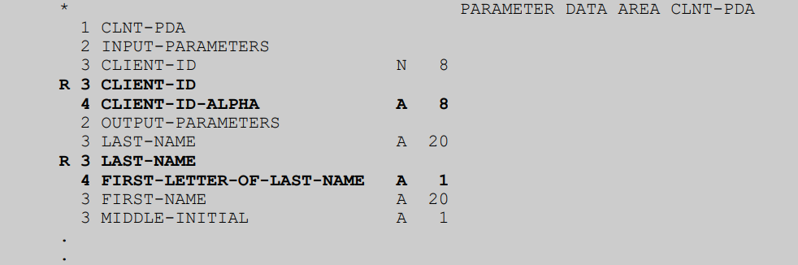
Redefining Data in LDA/PDA/GDA

Slide 26
Initialize the Data
By default, fields start out with a null value. For alphanumeric (format A) fields this is a space. For numeric fields (format N, P, B or I) this is zero. For date and time field (formats D and T) this is a null date and time. For logical fields (format L) this is a value of FALSE.

Slide 27
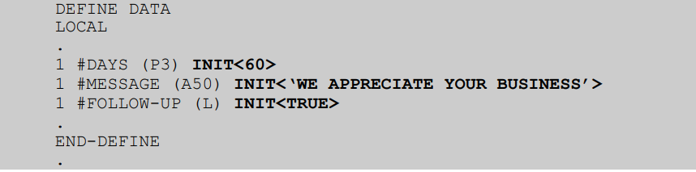
INIT
An initial value (one which can be subsequently changed by the executing logic) can be assigned using an INIT clause.
For alphanumeric fields, the initial value must be enclosed in single quotes.
You cannot assign an initial value to a field defined using a REDEFINE statement, but you can assign an
initial value to the “base” field.

Slide 28
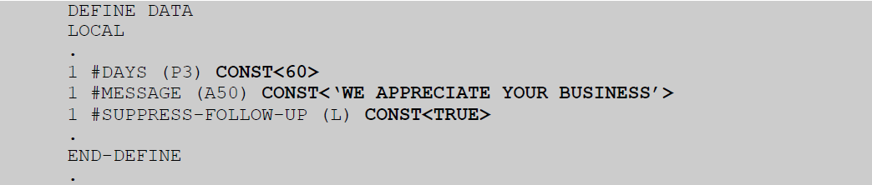
CONST
A constant value (one which cannot be changed by the executing logic) can be assigned using a CONST clause.

Slide 29
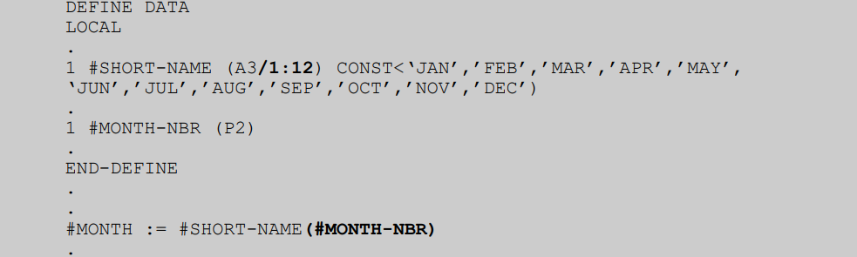
ARRAY
An array is simply multiple occurrences of a single field, or group of fields. 1, 2 and 3 level arrays are allowed.

Slide 30
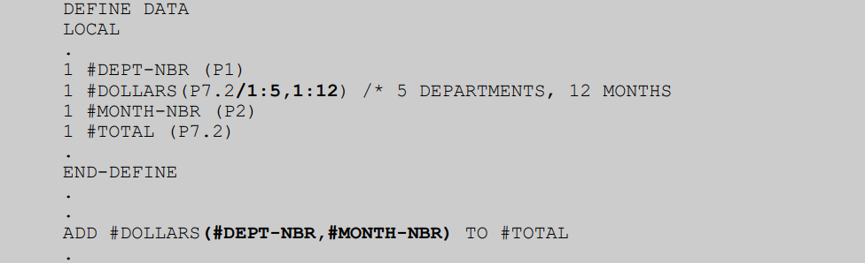
ARRAY – 2 level
In this example, the notation “/1:5,1:12” after the format and length definition defines 5 sets of 12 occurrences of the field. Each one is referenced by 2 indexes. In this example, the first index (representing the department) must be in the range 1 to 5; the second index (representing the month) must be in the range 1 to 12.
* You can define the Array in LDA as well.

Slide 31
ARRAY
DEFINE DATA
.
LOCAL
1 #CLIENT-ID (N8)
.
1 CLNT-REC (1:2) /* CLIENT RECORD, 2 OCCURRENCES
2 CLIENT-ID (N8)
2 LAST-NAME (A20)
2 REDEFINE LAST-NAME
3 FIRST-LETTER-OF-LAST-NAME (A1)
2 FIRST-NAME (A20)
2 MIDDLE-INITIAL (A1)
In this example, the notation “(1:2)” after the group name defines 2 occurrences of the group. Each elementary field within the group must be referenced by an index in the range 1 to 2.

Slide 32
ARRAY
DEFINE DATA
LOCAL
.
1 #SHORT-NAME (A3/1:12) CONST<‘JAN’,,MAR,,,JUN,,,,,,’DEC’>
1 REDEFINE #SHORT-NAME
2 #STRING (A36)
.
END-DEFINE
In this example, #STRING would contain “JAN MAR JUN DEC“.

Slide 33
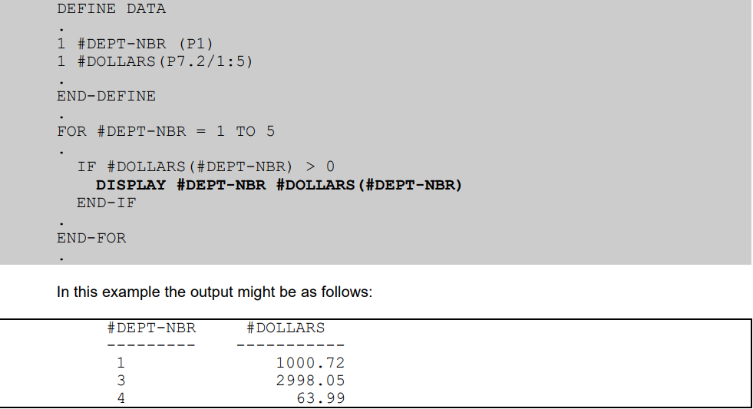
Natural Statement: DISPLAY
A simple way to output information from a module executing in batch mode is to use a DISPLAY statement. Output from DISPLAY statements is organized vertically with column headings, showing the names of the fields being displayed, being generated automatically and output at the top of each page.
Optionally a report number in the range 0 through 31 can be specified:
DISPLAY (1) #DEPT-NBR #DOLLARS(#DEPT-NBR)

Slide 34
Natural Statement: WRITE
WRITE statements offer more flexibility and control than DISPLAY statements by providing all of the following options:
· Casual output
· Automatic line wrap
· Formatted output using spacers
· Formatted output using tabs
· Formatted output using a combination of spacers and tabs
· WRITE USING FORM
Output from WRITE statements is organized horizontally to facilitate generating reports. WRITE statements are generally placed inside a processing loop and multiple lines of output are generated as a result. By default, a generic heading showing date and time is generated automatically and output at the top of each page.

Slide 35
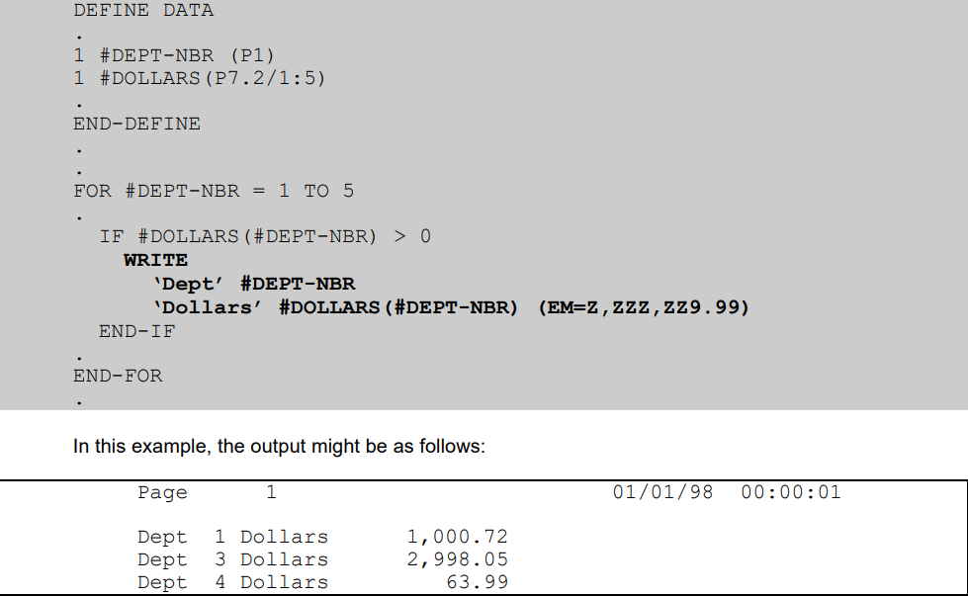
Natural Statement: WRITE

Slide 36
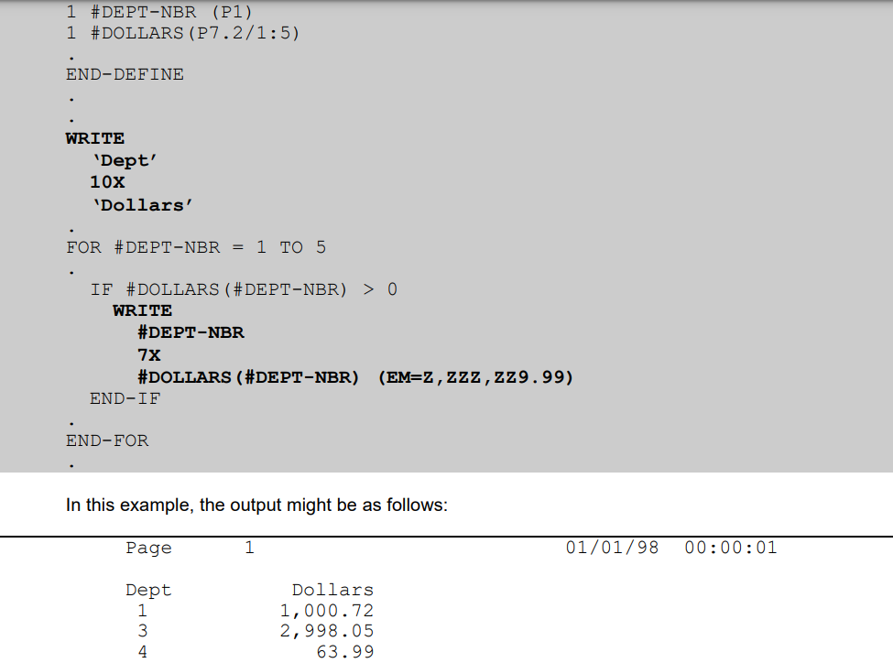
Natural Statement: WRITE - SPACES

Slide 37
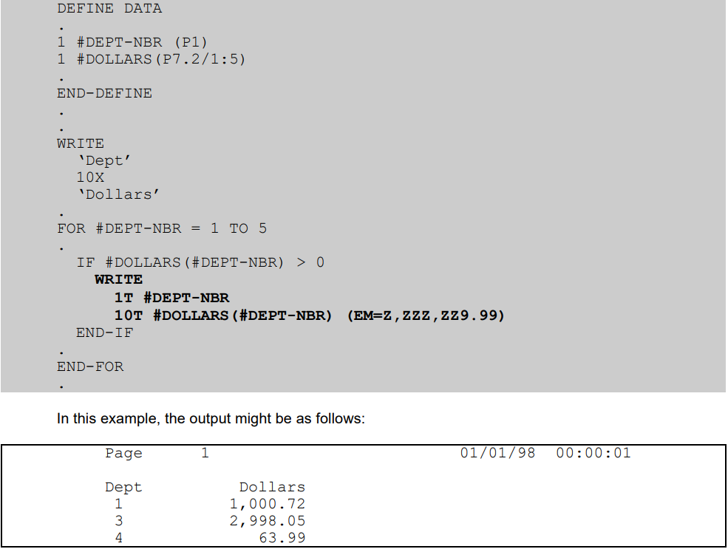
Natural Statement: WRITE - TABS

Slide 38
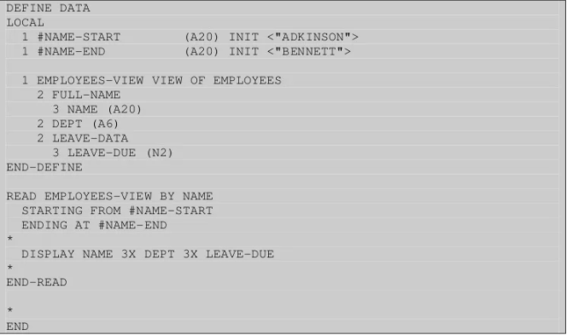
Natural : Example

Slide 39
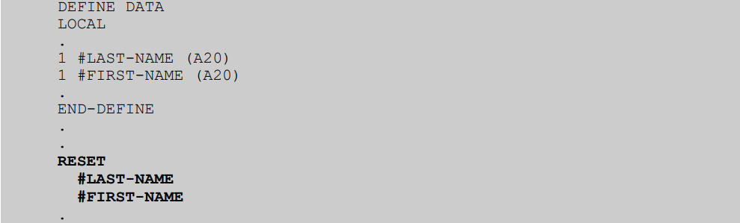
Natural Statement: Manipulate Data - Reset
RESET assigns a null value to elementary fields.
For alphanumeric (format A) fields this is a space. For numeric fields (format N, P, I or B) this is zero. For date and time field (formats D and T) this is a null date and time. For logical fields (format L) this is a value of FALSE.
By default, fields start out with a null value, so an initial RESET is unnecessary.

Slide 40
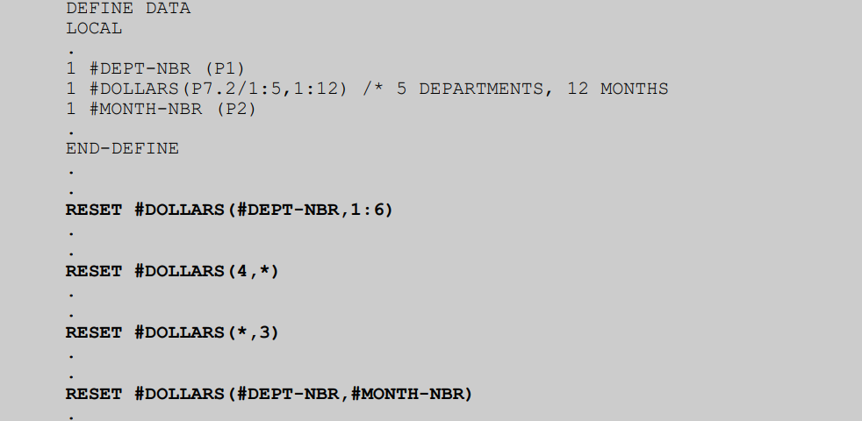
Natural Statement: Manipulate Data – Reset (Array)
When resetting an array, specific elements can be specified as illustrated above. “All” elements is represented by an asterisk, also illustrated above.

Slide 41
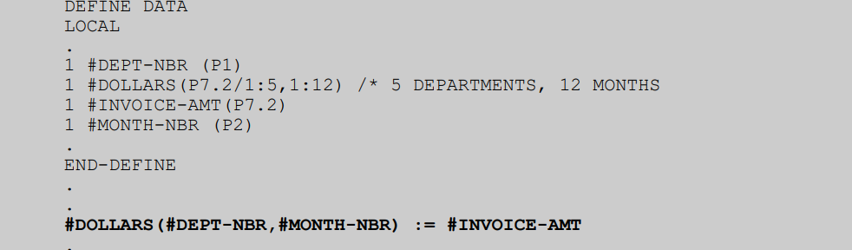
Natural Statement: Manipulate Data – :=
There are several direct assignment statements, including ASSIGN, COMPUTE and MOVE, but := (becomes equal to) is the quickest.
The “target” field is specified before the “:=“ symbol. The “source” field is specified after. The “source” field can be a literal, a variable or a formula.

Slide 42
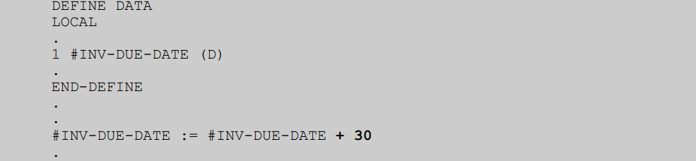
Natural Statement: Manipulate Data – := with arithmetic op
The “source field” is a formula which increases a date by 30 days. Note that NATURAL date (format D) fields can be manipulated in this way.

Slide 43
Natural Statement: Manipulate Data – COMPUTE
The COMPUTE statement is another direct assignment statement. COMPUTE must be used when rounding is required.
COMPUTE ROUNDED #SIX = #ELEVEN / #TWO
Assuming the variable #SIX is defined without decimal places, the result (5.5) would be rounded up to 6, per standard mathematical rules for rounding.
Contrast the above example with a COMPUTE statement without the ROUNDED clause:
COMPUTE #FIVE = #ELEVEN / #TWO
Assuming the variable #FIVE is defined without decimal places, the result (5.5) would be truncated to 5.

Slide 44
Natural Statement: Manipulate Data – ADD
The ADD statement can be used to change the value of a variable. Consider the following example:
ADD 30 TO #DUE-DATE
Although redundant to := (becomes equal to), an ADD statement increases the readability of your code. Compare the example above with the alternative:
#DUE-DATE := #DUE-DATE + 30

Slide 45
Natural Statement: Manipulate Data – SUBTRACT
The SUBTRACT statement can be used to change the value of a variable. Consider the following example:
SUBTRACT 30 FROM #DUE-DATE

Slide 46
Natural Statement: Manipulate Data – MOVE
The MOVE statement has several forms. The essential ones are as follows:
· MOVE EDITED
· MOVE BY NAME
· MOVE LEFT
· MOVE RIGHT

Slide 47
Natural Statement: Manipulate Data – MOVE Edited
MOVE EDITED allows you to format data using edit masks. Consider the following examples:
DEFINE DATA
LOCAL
.
1 #INVOICE-AMT (P7.2)
.
1 #PRINT-LINE
2 #INV-AMT (N7.2)
.
END-DEFINE
.
.
MOVE EDITED #INVOICE-AMT (EM=ZZZZZZ9.99-)
TO #P

Slide 48
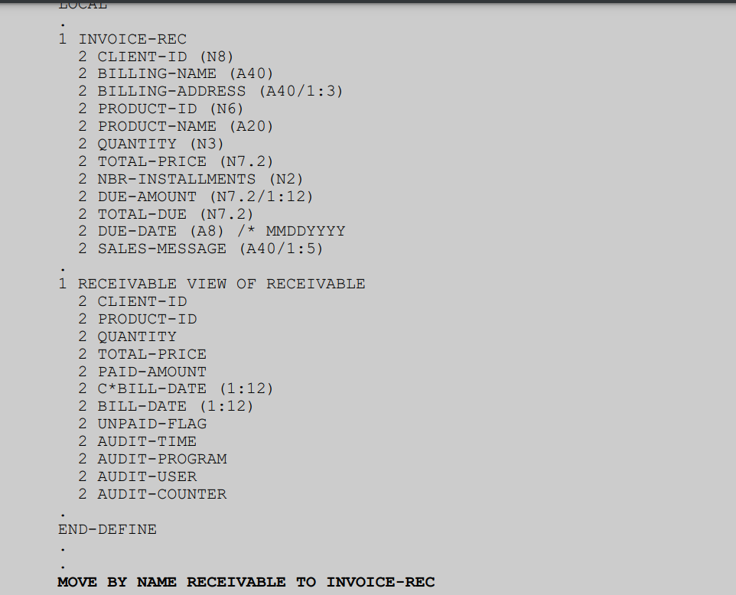
Natural Statement: Manipulate Data – MOVE BY NAME
MOVE BY NAME copies data from one record structure to another. Every elementary field with an identical name in both structures is copied.
If the format and/or length is different, the data is converted automatically. Any arrays common to both record structures must have an identical number of occurrences.

Slide 49
Natural Statement: Manipulate Data – MOVE LEFT
MOVE LEFT copies data into an alpha field, deleting any leading spaces so that the data is left-justified. Consider the following example:
MOVE LEFT #LAST-NAME TO #LAST-NAME

Slide 50
Natural Statement: Manipulate Data – MOVE RIGHT
MOVE RIGHT copies data into an alpha field, inserting leading spaces as necessary so that the data is right justified. Consider the following example:
MOVE RIGHT LAST-NAME TO #LAST-NAME

Slide 51
Natural Statement: Manipulate Data – MOVE ALL
MOVE ALL fills the target variable with a literal string, repeated as necessary. Consider the following examples:
MOVE ALL ‘?’ TO #LAST-NAME
MOVE ALL H‘FF’ TO #MAX-KEY

Slide 52
Natural Statement: Manipulate Data – COMPRESS
COMPRESS joins 2 or more strings. Consider the following examples:
DEFINE DATA
LOCAL
.
1 #ENJOY (A25) CONST<‘WE HOPE YOU ENJOY’>
1 #MESSAGE (A33)
1 #PRODUCT-NAME (A25)
.
END-DEFINE
.
.
#PRODUCT-NAME := ‘PAYING TOO MUCH ATTENTION’
.
COMPRESS #ENJOY #PRODUCT-NAME INTO #MESSAGE

Slide 53
Natural Statement: Manipulate Data – COMPRESS LEAVING NO SPACE
DEFINE DATA
LOCAL
1 #CLIENT-ID (N8)
1 REDEFINE #CLIENT-ID
2 #CLIENT-ID-ALPHA (A8)
.
1 #DEPT-NBR (P1)
1 #MESSAGE (A33)
.
END-DEFINE
.
#CLIENT-ID := 31722
#DEPT-NBR := 4
.
COMPRESS #DEPT-NBR ‘-’ #CLIENT-ID-ALPHA
INTO #MESSAGE LEAVING NO SPACE
o/p: 4-00031722”

Slide 54
Natural Statement: EXAMINE
EXAMINE REPLACE
EXAMINE DELETE
EXAMINE GIVING LENGTH
EXAMINE GIVING POSITION
EXAMINE GIVING INDEX

Slide 55
Natural Statement: EXAMINE REPLACE
This statement will replace a specific filed mentioned in the statement.
REPLACE FIRST – To replace only first filed
E.g.
#VAR := ‘EXAMINE CONCEPT IS VERY TOUGH”
EXAMINE #VAR FOR ‘TOUGH’ REPLACE WITH ‘EASY’
EXAMINE #VAR FOR ‘TOUGH’ REPLACE FIRST WITH ‘EASY’
Result : ‘EXAMINE CONCEPT IS VERY EASY’

Slide 56
Natural Statement: EXAMINE DELETE
This statement used to delete a specific string from the variable.
DELETE FIRST – To delete only first filed
E.g.
#VAR := ‘EXAMINE CONCEPT IS VERY EASY”
EXAMINE #VAR FOR ‘VERY’ DELETE
Result: ‘EXAMINE CONCEPT IS EASY’

Slide 57
Natural Statement: EXAMINE GIVING LENGHT/INDEX/POSITION
EXAMINE GIVING LENGTH statement will give the length of a string.
The EXAMINE GIVING LENGTH give the updated result if it is using with EXAMINE DELETE statement.
EXAMINE GIVING POSITION find the past of the string and returns the position of the first character.
EXAMINE GIVING INDEX using with an ARRAY filed. It find a specified value within an array and returns the index num.

Slide 58
Natural Statement: EXAMINE GIVING LENGHT/INDEX/POSITION
VAR := ‘THIS IS AN EXAMPLE OF EXAMINE’
#ARRAY (A2/1:5) CONST <‘AA’, ‘BB’, ‘CC’, ‘DD’, ‘EE’>
EXAMINE #VAR FOR ‘E’ GIVING LENGTH IN #LENGTH
EXAMINE #VAR FOR ‘E’ DELETE GIVING LENGTH IN #LENGTH
EXAMINE #VAR FOR ‘EXAMPLE’ GIVING POSITION IN #POSITION
EXAMINE #ARRAY(*) FOR ‘BB’ GIVING INDEX IN #INDEX

Slide 59
Natural Statement: EXAMINE FULL
If FULL is not specified, trailing blanks in the operand will be ignored. If FULL is specified for an operand, the entire value, including trailing blanks, will be processed.
Basically, FULL means trailing blanks count.
Define Data Local 01 #array (A5/1:10) 01 #index end-define ** move '12345' to #array(1) move '34567' to #array(2) examine full #array(*) for " " giving index in #index write #index end
Result : 3 where it finds first blank occurrence

Slide 60
Natural Statement: EXAMINE FULL
1 #A (A10) INIT <'AB C'> EXAMINE #A FOR ' ' GIVING NUMBER #N
Result : 1 EXAMINE FULL #A FOR ' ' GIVING NUMBER #N
Result : 7

Slide 61
Natural Statement: EXAMINE FULL
#A (A30) INIT <'LOOKING FOR WORDS THAT END IN R'> 1) EXAMINE #A FOR 'R ' GIVING NUMBER #N
Result : 3 2) EXAMINE #A FOR FULL 'R ' GIVING NUMBER #N
Result : 1
3) EXAMINE FULL #A FOR FULL 'R ' GIVING NUMBER #N
Result : 2
1) without the word FULL before 'R ' this is looking for R's.
2) with the word FULL, this is looking for 'R '. HOWEVER, without the word FULL before #A, the final R (which does have a blank, actually a bunch of them, after the R) does not count
3) with both FULLs, the final R counts

Slide 62
Natural Statement: EDITED MASK
Edit Mask is used to format a data.
MOVE EDITED allows you to format data using edit masks.
1. MOVE EDITED operand1 TO operand2 (EM=value) 2. MOVE EDITED operand1 (EM=value) TO operand2
Statement 1 is a ‘De edit’ statement, that takes operand1 and removes the editing characters in the edit mask to create operand2.
Statement2 takes the operand1 and applied the specific edit mask to create operand2.

Slide 63
Natural Statement: EDITED MASK
DEFINE DATA LOCAL 1 #DAT (N8) 1 REDEFINE #DAT 2 #DAT-A (A8) 1 #DAT-A-10 (A10) 1 #DATE (D) END-DEFINE #DAT := 20090729 * MOVE EDITED #DAT-A TO #DATE (EM=YYYYMMDD) * MOVE EDITED #DATE (EM=YYYY/MM/DD) TO #DAT-A-10 * END -----------------------------------------------------------------
MOVE *DATX TO #DAT-A –- (MM/DD/YY)
MOVE EDITED #DAT-A TO #DATE(EM=MM/YY//DD)
MOVE EDITED #DATE(EM=MM/DD/YYYY) TO #DAT-A-10

Slide 64
Natural Statement: EDITED MASK
DEFINE DATA LOCAL
*
01 #N1 (N7.3) INIT <-123456.789>
01 #A (A40)
END-DEFINE
*
MOVE EDITED #N1(EM=+ZZZZZZ999.99) TO #A
WRITE #A
END

Slide 65
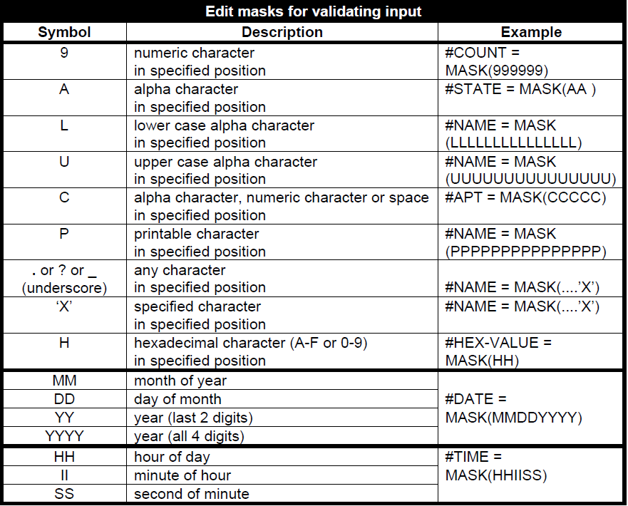
Natural Statement: EDITED MASK

Slide 66
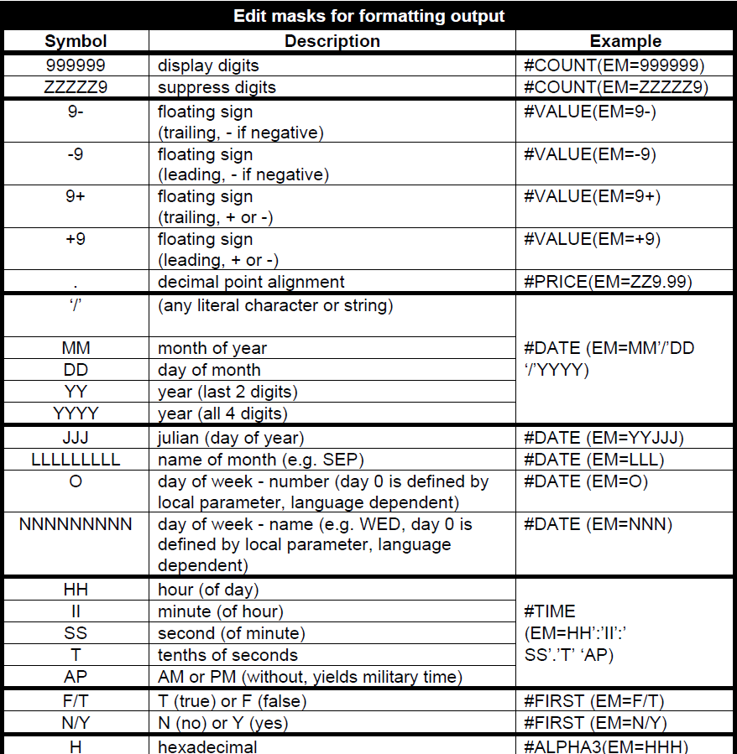
Natural Statement: EDITED MASK

Slide 67
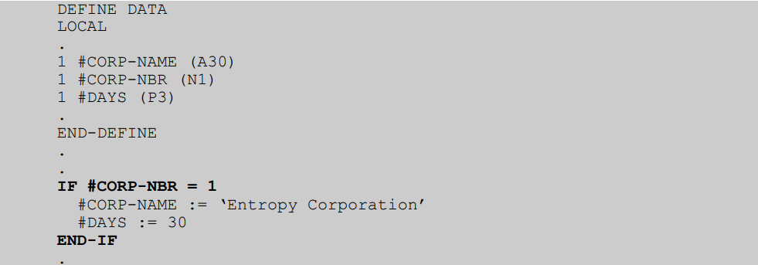
Natural Statement: Flow Control - IF
IF allows you to conditionally execute one or more statements. The statements to be executed immediately follow the IF and terminate with END-IF. By using an ELSE clause, you can execute statements if the condition is false.

Slide 68
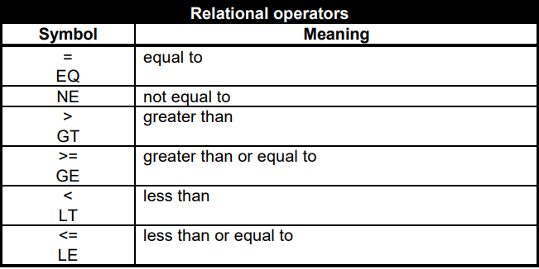
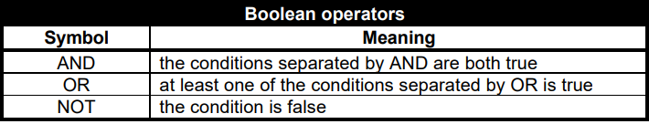
Natural Statement: Flow Control - IF

Slide 69
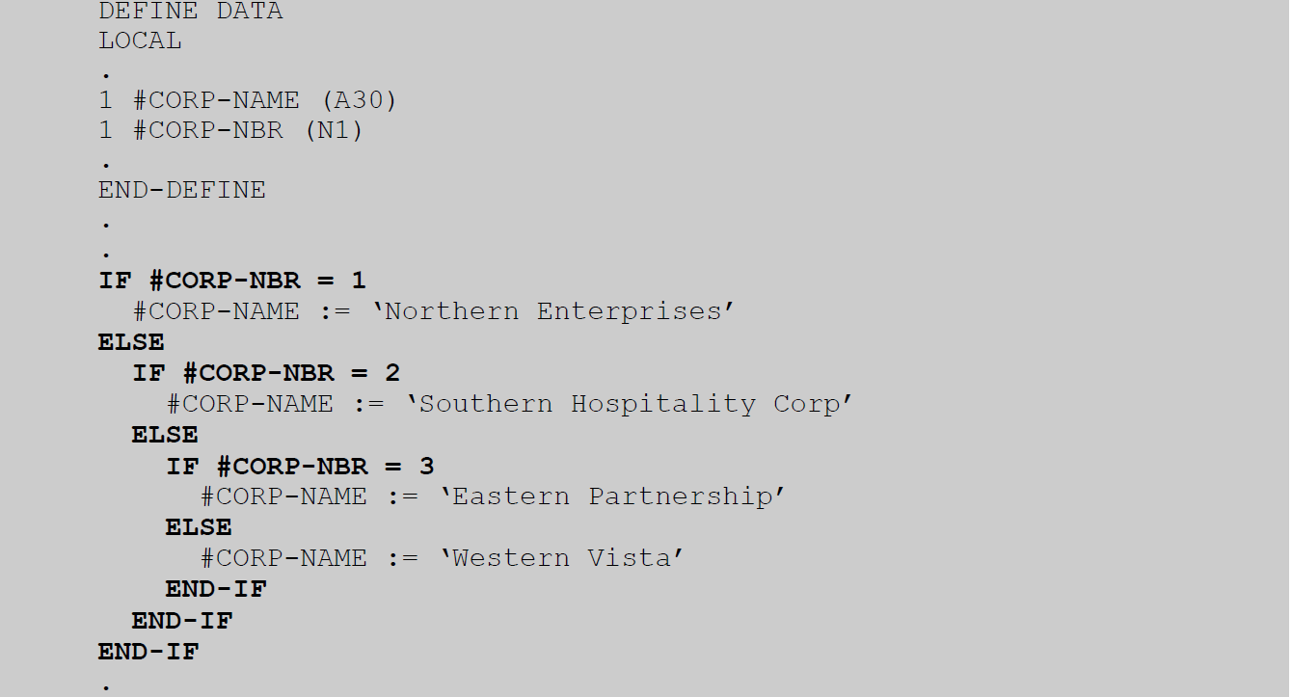
Natural Statement: Flow Control – NESTED IF

Slide 70
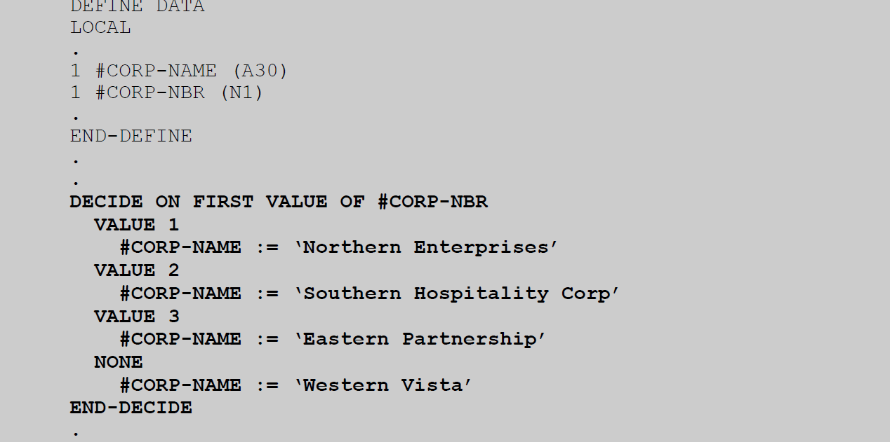
Natural Statement: Flow Control – DECIDE ON
DECIDE ON allows you to list possible values for a field and to specify different actions for each value, in a very readable way. DECIDE ON statements terminate with END-DECIDE.

Slide 71
Natural Statement: Flow Control – DECIDE ON
Multiple values can be specified in a single VALUE clause, for example:
VALUE 1, 5, 7:10
A NONE clause is mandatory to specify an action for an undocumented value.
Since a NONE clause is mandatory, it is sometimes necessary to specify a “null” action. This is done using an IGNORE statement.

Slide 72
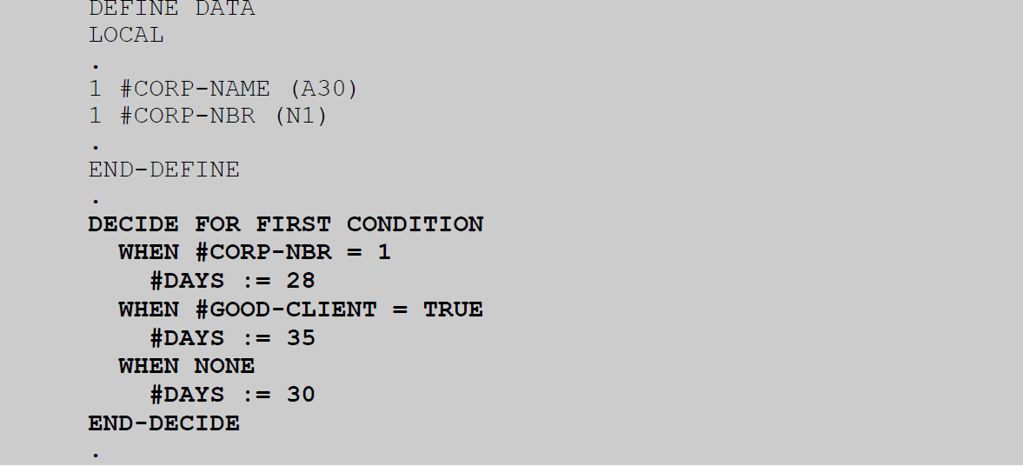
Natural Statement: Flow Control – DECIDE FOR
DECIDE FOR allows you to list possible conditions and to specify different actions for each condition.
DECIDE FOR statements terminate with END-DECIDE.

Slide 73
Natural Statement: Flow Control – DECIDE FOR
Unlike a DECIDE ON statement where one field is referenced and the actions vary by the value of the
field, a DECIDE FOR statement is much more flexible. Each condition within the DECIDE can
reference any field.
In a DECIDE FOR statement the sequence of conditions is very significant. Conditions are evaluated
sequentially, i.e. from the top down.
* The WHEN NONE clause is mandatory.

Slide 74
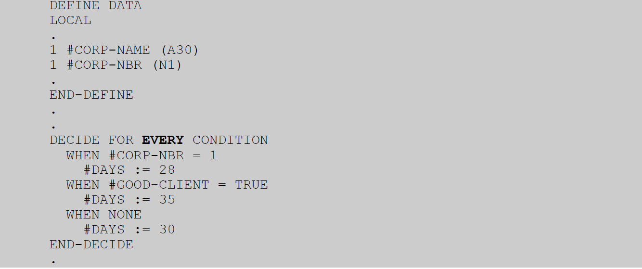
Natural Statement: Flow Control – DECIDE FOR EVERY

Slide 75
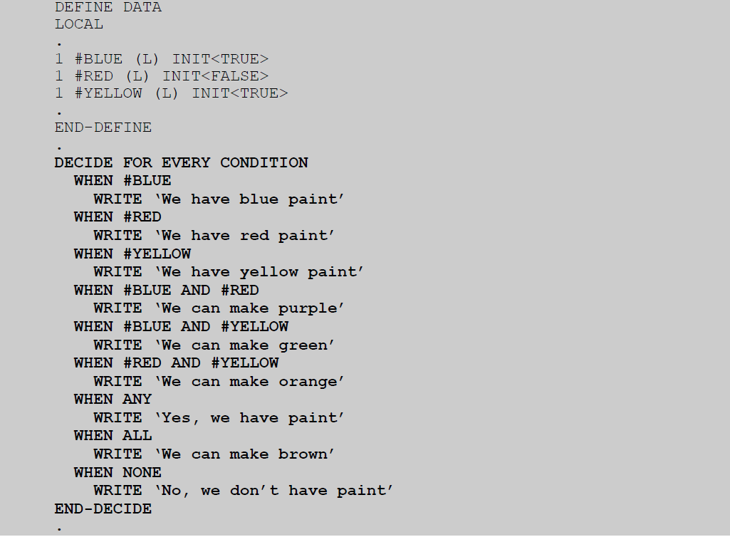
Natural Statement: Flow Control – DECIDE FOR EVERY with ANY , ALL

Slide 76
Natural Statement: Flow Control – DECIDE FOR EVERY with ANY , ALL
Optionally, a WHEN ANY clause can be placed before the mandatory WHEN NONE clause. If
present, the specified actions will be taken if any of the preceding conditions are true.
Similarly, a WHEN ALL clause can optionally be placed before the mandatory WHEN NONE clause. If
present, the specified actions will be taken if all of the preceding conditions are true.

Slide 77
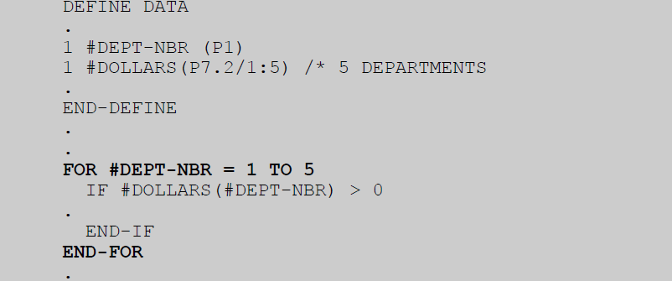
Natural Statement: Flow Control – FOR
FOR automatically increments (or decrements) a control variable which can be used by logic contained inside the associated processing loop. The top of the loop is marked by the FOR statement, the bottom is marked by END-FOR.

Slide 78
Natural Statement: Flow Control – FOR
By default the control variable is incremented by 1. It can be incremented by a different number, or
decremented: Consider the following examples:
FOR #ODD-INDEX = 1 TO 99 STEP 2
FOR #DOWN-INDEX = 99 TO 1 STEP -1

Slide 79
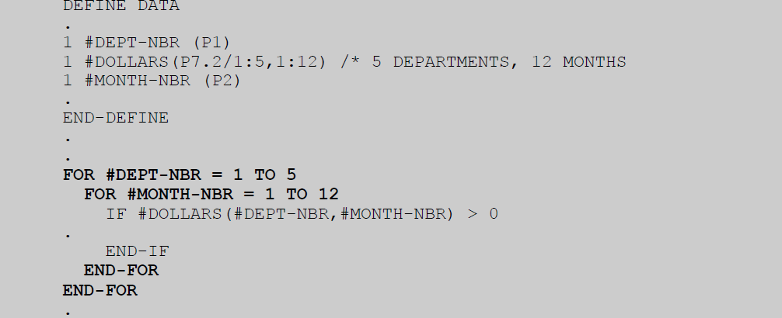
Natural Statement: Flow Control – NESTED FOR

Slide 80
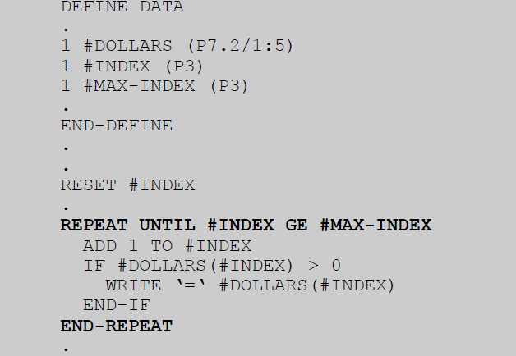
Natural Statement: Flow Control – REPEAT
REPEAT allows you to create a processing loop around logic so that it can be executed multiple times until a specified condition becomes true. The top of the loop is marked by the REPEAT statement, the bottom is marked by END-REPEAT.

Slide 81
Natural Statement: Flow Control – REPEAT/FOR tips
The UNTIL clause is optional. Without one, an unconditional loop is created. Unconditional loops can be terminated using an ESCAPE statement, as described in a later section.
* Generally, REPEAT is used when the number of iterations is not fixed, and termination of the processing loop is dependent on a dynamic condition.
* Generally, FOR is used when the number of iterations is fixed. In this scenario, using a FOR
statement rather than a REPEAT statement adds readability.

Slide 82
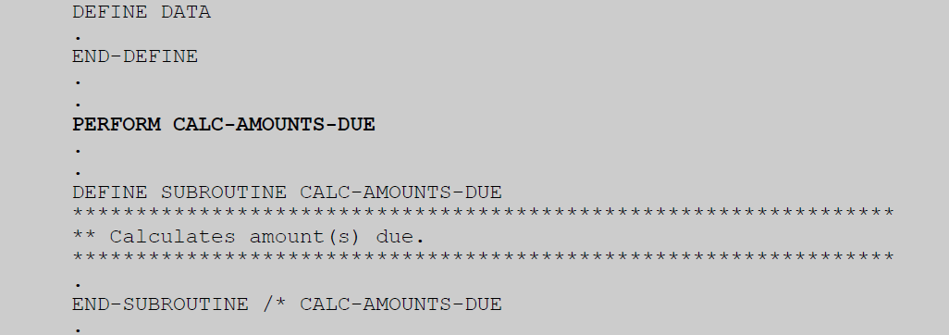
Natural Statement: Flow Control – PERFORM
PERFORM executes a subroutine. If a subroutine with the specified name is contained within the same module as the PERFORM statement, it will be executed. If not, NATURAL will look for an external subroutine.
An execution time error will occur if the subroutine is not found. When the subroutine finishes executing, control passes to the statement following the PERFORM.

Slide 83

Natural Statement: Flow Control – CALLNAT
CALLNAT executes a subprogram. An execution time error will occur if the subprogram is not found. When the subprogram finishes executing, control passes to the statement following the CALLNAT.

Slide 84
Natural Statement: Flow Control – FETCH
The FETCH statement allows you to to invoke and pass control to a NATURAL program. It can be used in a program or at a higher level, i.e. in a subprogram or subroutine. It has 2 forms, as follows:
· FETCH
· FETCH RETURN

Slide 85
Natural Statement: Flow Control – STOP
STOP causes application execution to cease.
Command : STOP
A STOP statement can be used in a program or at a higher level, i.e. in a subprogram or subroutine. Regardless of where it is used, execution of the active module and all lower level modules ceases.
STOP is generally used only to terminate an application following a fatal error.

Slide 86


Natural : Example

Slide 87
Natural Statement: ESCAPE
The ESCAPE statement allows you to exit a routine or processing loop, or to terminate an iteration of a processing loop. It has 3 forms, as follows:
· ESCAPE TOP
· ESCAPE BOTTOM
· ESCAPE ROUTINE
ESCAPE TOP and ESCAPE BOTTOM can be used in conjunction with any statement that creates a processing loop, such as FIND, FOR, HISTOGRAM, READ, READ WORK FILE, REPEAT, etc.
ESCAPE ROUTINE can be used in conjunction with a subroutine, subprogram or helproutine. It can also be used in conjunction with a program, where it acts as a STOP statement.

Slide 88

Natural Statement: ESCAPE TOP

Slide 89

Natural Statement: ESCAPE BOTTOM

Slide 90

Natural Statement: ESCAPE BOTTOM/TOP

Slide 91

Natural Statement: ESCAPE BOTTOM with label

Slide 92
Natural Statement: ESCAPE ROUTINE
ESCAPE ROUTINE exits the current routine. The current routine may be a program, subprogram, subroutine or helproutine.
In the case of a program, execution terminates completely.
In the case of a subprogram,subroutine or helproutine, control passes to the statement following the “call”.
In the case of a subroutine,control passes to the statement following the PERFORM.

Slide 93

Natural Statement: ESCAPE ROUTINE

Slide 94

MAP editor
When the Map Editor is invoked (e.g. E M from the NATURAL command line), the main menu is presented:

Slide 95
MAP editor
E - Edit Map : This option allows you to edit an existing map.
I - Initialize new Map : This option allows you to initialize a new map from an existing profile.
H - Initialize a new Help Map
This option allows you to initialize a new help map from an existing profile. The default profile for ahelp map may be different from the default profile for a regular map. Use of this option identifies the map as a help map and causes some editing restrictions to be invoked.
M - Maintenance of Profiles & Devices : This option allows you to create a new profile or change an existing one.
S - Save Map : This option allows you to save the source version of the map.
T - Test Map : This option allows you to review how the map will look when presented to the user.
W - Stow Map : This option allows you to create an object version of the map.
? – Help : This option allows you to access Map Editor help information.
. – Exit : This option allow you to exit the Map Editor.

Slide 96
MAP editor
When the Map Editor is invoked (e.g. E M from the NATURAL command line), the main menu is presented:

Slide 97

MAP profile
When creating a new map module, a profile is used to control the default map settings for such things as:
· number of lines and columns
· identifying different classes of fields
· assigning intensity
· upper/lower case
· filler character for input/modifiable fields
You can edit the profile or change current map settings at any time, by entering a code of M (maintenance of profiles & devices) on the above menu.

Slide 98

MAP profile
This screen allows you to create and maintain profiles. It also allows you to change the current map settings.
When you enter a code of C (change map settings of current map), a screen similar to the following is returned:

Slide 99

MAP field: Delimiters
The delimiter characters used to signal the start of a field, its class and its intensity, are determined by the current map settings. The edit screen shows the available delimiters in the top right corner:
In this case, the delimiters of interest are:
· blank to identify a text field with default intensity
· “?” to identify a text field with high intensity
· “¬” to identify a non-display input field
· “&” to identify a modifiable field with default intensity
· “:” to identify a modifiable field with high intensity
· “+” to identify an output field with default intensity
· “(“ to identify an output field with high intensity

Slide 100
MAP field: Delimiters
The delimiter characters used to signal the start of a field, its class and its intensity, are determined by the current map settings. The edit screen shows the available delimiters in the top right corner:
In this case, the delimiters of interest are:
· blank to identify a text field with default intensity
· “?” to identify a text field with high intensity
· “¬” to identify a non-display input field
· “&” to identify a modifiable field with default intensity
· “:” to identify a modifiable field with high intensity
· “+” to identify an output field with default intensity
· “(“ to identify an output field with high intensity

Slide 101
MAP : Create a new MAP
Step 1 - Initialize new map
Select option I, enter a module name (mandatory) and a profile name (optional). Press ENTER.
Step 2 - Adjust map settings
Adjust map settings, overriding the defaults obtained from the profile, as necessary. Press ENTER.
Step 3- Create text fields
Since text fields are easy to move around, you may find it helpful to initially create all map fields as text fields. When you’re happy with the layout, you can then replace some of the text fields with nontext fields, as appropriate.
This is best done using “full screen” mode. PF9 toggles between “half screen” and “full screen” modes.

Slide 102

MAP : Create a new MAP - example

Slide 103

MAP : Create a new MAP - example
The Ob (object) prompt in the top left corner allows you to list the relevant parts of another source module and reference the data fields or variables directly.
Type in the module type (P for program, N for subprogram or L for LDA, etc.) followed by the module name and press ENTER. This lists the relevant parts of the specified module.

Slide 104
MAP : Tips
For each map field which relates to a data item, do the following:
1. position the cursor at the character immediately preceding the first character of the map field
2. select and type the appropriate delimiter (e.g. &)
3. type the relevant data item number (or letter) from the top portion of the screen
4. space over the text representing the field (e.g. XXX)
Press ENTER to attach the data items to the map fields.
To scroll through the map fields, press PF8 or PF7 until the required map fields are displayed.
By positioning the cursor on the name of the module and pressing PF1, you can invoke a
little-publicized Map Editor feature giving you the ability to:
· view a full screen list of available data items
· scroll through the full screen list a page at a time
· select a field from the long list as the top of the normal list

Slide 105

MAP : Editor Command
The .E (edit field definition) command allows you to change the definition of a field. In response to this command, field information is displayed in the top part of the edit screen.

Slide 106

MAP : Editor Command - Attribute Definition

Slide 107
MAP : Editor Command – Help routine
The HE parameter allows you to specify the name of a field-level helproutine. This could be a map module or an executable helproutine module. The specified helproutine will be executed if the user enters a help character (“?” by default) in the first character position of the field or positions the cursor anywhere on the field and presses the help key (PF1 by convention).
The name of the helproutine module must be specified in quotes. Optionally, parameter data, which is passed to the helproutine module, may also be specified. There is a limit of 20 such parameters, and each must be separated by a comma. Parameters may be literal values enclosed in quotes or the names of map fields.
If the HE parameter is null and the user invokes field-level help, screen-level help may be given instead. Screen-level help is defined in the same way, but using the map profile screen.

Slide 108

MAP : Editor Command - Color definition

Slide 109
MAP : Editor Command – Edit mask
The EM parameter allows you to specify an edit mask which will be used to format output and validate input. Since the Map Editor is case-sensitive, be sure to explicitly enter characters in upper case, where appropriate.
The default value for each of the above parameters varies from site to site. When editing is complete, press ENTER to return to the edit screen.

Slide 110

MAP : Editor Command
The .A (edit array definition) command allows you to define or change the definition of an array of map fields. The repeating map fields are attached to a repeating data item, allowing multiple occurrences of the data to be displayed. You can specify which occurrences to display and in what format.

Slide 111

MAP : Editor Command
The “upper bounds” information in the top right corner of the screen shows the dimensions of the array - in this case, a 1-dimensional array with 3 occurrences.
It makes sense to arrange the map fields vertically. Since this is the default, we would only need to specify the number of occurrences to be displayed, the index value for the first occurrence to be displayed and the number of blank lines between each occurrence.

Slide 112

MAP : Editor Command

Slide 113
Natural Statement: INPUT
The INPUT statement has several uses and takes several forms. In on-line mode it used to obtain data from the user in real-time, most commonly utilizing a pre-defined screen layout that has been stored as a map module.

Slide 114

Natural Statement: INPUT USING MAP
In on-line applications, INPUT USING MAP is the normal way to display data to the user and to receive input data, using a pre-defined screen layout represented by a map module.
In this example, map IVCLNTM1 is output without a message and with the cursor positioned at the first input field (by default).

Slide 115

Natural Statement: INPUT USING MAP WITH TEXT
In this example, map IVCLNTM1 is output with the contents of #MSG-1 in the message area and the cursor positioned at the first input field.

Slide 116

Natural Statement: INPUT USING MAP WITH ALARM
In this example, map IVCLNTM1 is output with the contents of #MSG in the message line and the cursor positioned at the first input field. The alarm (usually a single beep) will sound to attract user attention.

Slide 117

Natural Statement: INPUT USING MAP WITH MARK
In this example, map IVCLNTM1 is output with the cursor positioned at the field attached to variable
#MAP.#ACTION.

Slide 118

Natural Statement: REINPUT
REINPUT passes control to the most recently executed INPUT statement. This provides a useful escape from validation logic when an error is detected. The statement provides a clean way to output an error message and return control to the user.

Slide 119
Natural Statement: DEFINE WINDOW
The DEFINE WINDOW statement defines a window which may (or may not) be subsequently activated during processing. A full-screen window occupies the entire screen. A part-screen window occupies only part of the screen with the original screen as background. When a window is active, only fields within that window are accessible.
Although multiple windows can be open simultaneously, only one can be active.
Consider the following examples:
DEFINE WINDOW WINDOW-1
In this example, WINDOW-1 is defined. Default values will apply

Slide 120
Natural Statement: DEFINE WINDOW
DEFINE WINDOW WINDOW-2
SIZE 14 * 45
BASE 6/18
TITLE ‘Receivables’
In this example, WINDOW-2 is defined. Default values will apply as follows:
· window background will not be reverse video
· active message area will be inside the window
· window will be framed

Slide 121
Natural Statement: SET WINDOW
The SET WINDOW statement either activates (opens) a new window or deactivates (closes) an active one.
The window must have been previously defined using a DEFINE WINDOW statement. Consider the following
examples:
Example 1: Activating a window
SET WINDOW ‘WINDOW-2’
In this example, WINDOW-2 is opened and activated. The previously active window (if any) is
deactivated, but left open.
Example 2: Deactivating a window
SET WINDOW OFF

Slide 122

Natural Statement: INPUT WINDOW USING MAP
The WINDOW clause of an INPUT (USING MAP) statement indicates that the map is to be executed for the specified window. The window must have been previously defined using a DEFINE WINDOW statement and optionally activated using a SET WINDOW statement. If the window is too small, data will be truncated at the right and bottom borders.

Slide 123
Natural Statement: SET KEY
The SET KEY statement activates or deactivates PF keys. In on-line programs, the executing module must explicitly activate the keys which the user will need to terminate input. It can also be used to assign names which are then displayed automatically to the user on the PF-key prompt line. A SET KEY statement should be executed before the first INPUT statement. By default, PF keys are inactive until explicitly activated.
Example 1: Activate PF3
SET KEY PF3
In this example, PF3 is activated and made available to the user.
Example 2: Deactivate PF7 and PF8
SET KEY
PF7=OFF
PF8=OFF
In this example, PF7 and PF8 are deactivated and made unavailable to the user.
Example 3: Activate PF8 named “Fwd” (forward)
SET KEY PF8 NAMED ‘Fwd’

Slide 124
Natural Statement: FORMAT
The FORMAT statement allows you to override the default value of a NATURAL session parameter. It is commonly used to specify line size and/or page size. Line size is the number of characters per line (e.g. 132).
Page size is the number of lines per page (e.g. 60). As with WRITE, DISPLAY, etc. a report number can optionally be specified.
Consider the following examples:
FORMAT LS=132 PS=60
FORMAT (2) PS=60

Slide 125
Natural Statement: NEWPAGE
The NEWPAGE statement allows you to force a new page. As with WRITE, DISPLAY, etc. a report number can optionally be specified.
Consider the following examples:
NEWPAGE
NEWPAGE (2)

Slide 126

Natural Statement: AT TOP OF PAGE
AT TOP OF PAGE allows you to automatically execute one or more statements whenever a new page is started.
The statements to be executed immediately follow the AT TOP OF PAGE and terminate with ENDTOPPAGE. It is typically used with logic to print page headings. As with WRITE, DISPLAY, etc. a report number can optionally be specified.

Slide 127

Natural Statement: *PAGE-NUMBER
NATURAL automatically keeps track of page numbers. The current page number for any report can be obtained (in P5 format) using system variable *PAGE-NUMBER.

Slide 128
Natural Statement: * system variables
System variable *DATX returns the current date in D (internal date) format.
System variable *TIMX returns the current date and time in T (internal time) format.
System variable *USER returns the id of the current user in A8 format. For modules executing on-line, this is the current user’s logon id. For modules executing in batch mode, this is the name of the batch job.
System variable *PROGRAM returns the name of the currently executing module in A8 format.
System variable *DEVICE returns a value (in A8 format) indicating whether the current module is executing in batch mode. A value of “BATCH” indicates batch mode. Any other value indicates on-line mode.

Slide 129

Natural Statement: * system variables

Slide 130

Natural Statement: Function - VAL
System function VAL (value) returns a numeric value derived from an alpha string containing only valid numeric digits.

Slide 131

Natural Statement: Function - SUBSTR
System function SUBSTR (substring) returns part of a string.

Slide 132
Thank You

